Slide 1
Research Integrity | Ethnography
Doing Political Research, Week 8

Slide 2
Research Integrity
What are the key challenges to research integrity?
How effective are the following strategies to improve the production of political research? What advantages and drawbacks do they have?
Peer-review
Pre-registration of research plans
Publishing null results, formally or informally
Data transparency
To what extent are these strategies compatible with qualitative and non-positivist research?

Slide 3
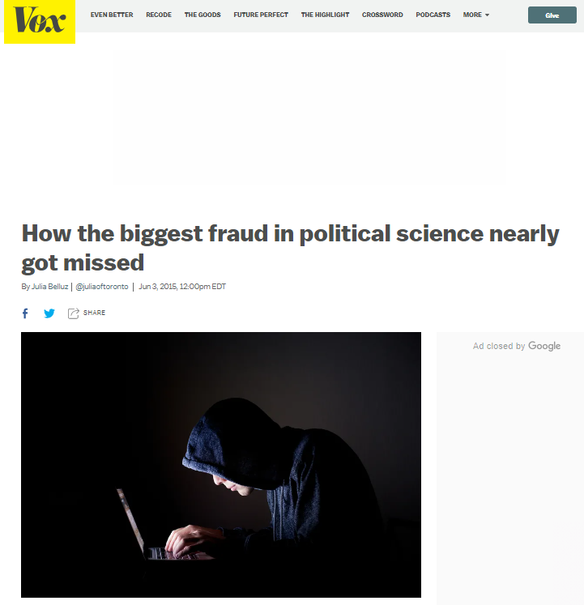
The LaCour Scandal
Why did LaCour fabricate data? What role did institutional and structural factors play?
How effective would proposed interventions to improve research integrity have been in preventing this scandal?
Does the uncovering of the scandal prove that current research integrity initiatives are effective?
What else could be done to prevent similar scandals in the future?

Slide 4
Designing an Ethnographic Research Project
Choose a research question to investigate a political process or phenomenon and design an ethnographic study to research it.
Which research site(s) will you observe? For how long? How will you gain access?
Will you be overt or covert? To what extent will you (be able to) participate?
How will you record your observations? What other practical issues will you need to account for?

Slide 5
Blume
How did Blume gain access to her field sites? Was she overt or covert?
How robust are her findings? To what extent can her findings be generalised?
How well does she account for her positionality?
How could the study have been improved? What other methods could have been used?

